Slide 1

Safety Analysis: ABC Company
AIRLINE SAFETY
DSC 640 Project Task 5 by Mary Donovan Martello

Slide 2
Introduction
Is air travel save for you?
We look at the data to help you decide if air travel is for you.

Slide 3
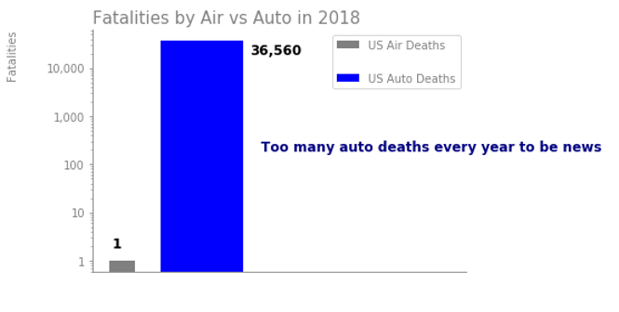
Media Reports
Auto Crashes are Not News – but Airline Crashes Make News

Slide 4
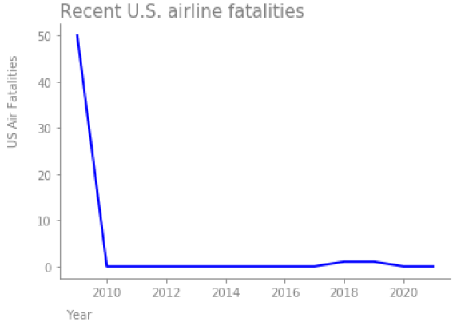
U.S. Airline Safety Record - Excellent
0
ZERO fatalities from passenger crashes in 10 of the last 12 years; and only TWO fatalities in the last 12 years
2

Slide 5
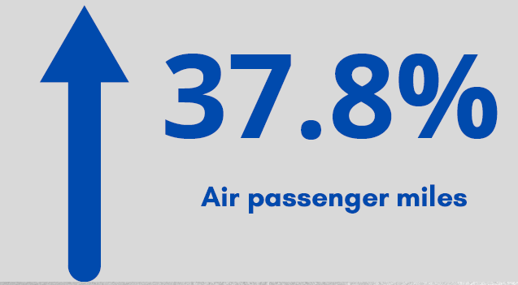
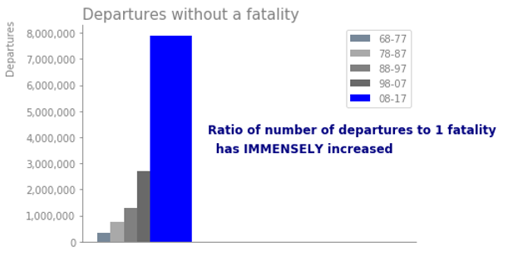
Fatalities DOWN; Use UP
Safety Ratio UP
Air fatalities are declining as passenger use of air travel increases.
over the past 15 years.

Slide 6
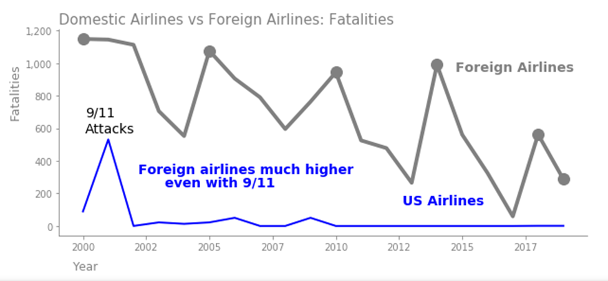
US Airlines Safer than Foreign Airlines
Foreign airline fatalities are much higher than US airlines.

Slide 7
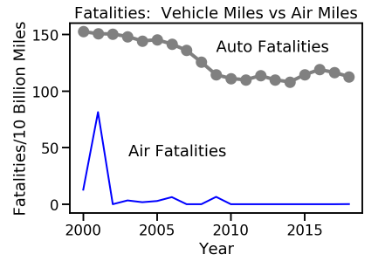
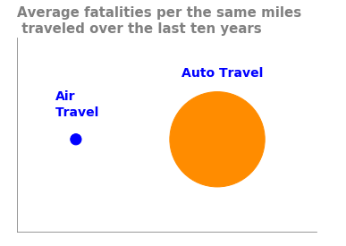
Auto Fatality Rate Much Higher than Air
103.4 times

Slide 8
Summary
Foreign airlines are having crashes that create news.
U.S. commercial passenger airlines have an excellent safety record in the past decade.
U.S. commercial passenger airline safety ratios are only improving because air miles and departures are increasing.
Air travel is still much safer than auto travel compared on a per mile traveled basis.
U.S. air travel is safe!
Book your flight today!

